Slide 1
DIGITAL HEALTHCARE SOLUTION
Doctor Appointment
Booking System
Streamlining Patient Access, Provider Scheduling, and Healthcare Operations
PROJECT TEAM MEMBERS
Ramuni Rakesh
A. Raju
25MVCSMR0167
25MVCSMR0100
K. Shashikanth
V. Jeshwanth Chari
25MVCSMR0129
25MVCSMR0180

Slide 2


INDUSTRY NEED
Transforming Patient Access & Scheduling
Traditional Bottlenecks
Digital Solution
Long Phone Holds: High wait times for manual reception bookings.
24/7 Self-Booking: Instant slot reservation anytime, anywhere.
High No-Show Rates: Lack of automated reminders leads to lost revenue.
Automated Alerts: Multi-channel SMS and WhatsApp notifications.
OPD Congestion: Unmanaged walk-in queues and crowding.
Smart Queue Tokens: Real-time doctor availability and token tracking.

Slide 3



CORE PLATFORM CAPABILITIES
Key System Features
Doctor Directory
Real-Time Slots
Smart Alerts
Telehealth Sync
Search providers by specialty, experience, rating, and geographic location.
Dynamic slot allocation preventing double booking and optimizing schedule density.
Automated confirmation messages and reminder notifications before appointments.
Seamless integration with secure video calls for virtual consultations.

Slide 4
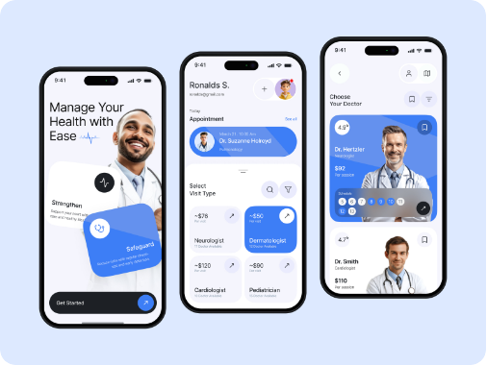
END-TO-END JOURNEY
Patient Booking Workflow
1
Search & Selection
Filter doctors by specialty, ratings, location, and fee structure.
2
Slot Selection & Payment
Pick preferred date/time slot and complete digital intake form.
3
Confirmation & Reminders
Receive digital token, calendar event, and automated SMS alerts.
4
Consultation & E-Prescription
Attend clinic/telehealth visit and receive digital consultation summary.

Slide 5

CLINICAL OPERATIONAL VALUE
Elevating In-Clinic Experience
Zero Wait-Time Anxiety
Live token tracking informs patients of current doctor queue status.
Pre-Visit Digital Intake
Medical history uploaded before arrival, saving clinic registration time.
Seamless Follow-ups
One-click rebooking and lab test scheduling right from consultation room.

Slide 6
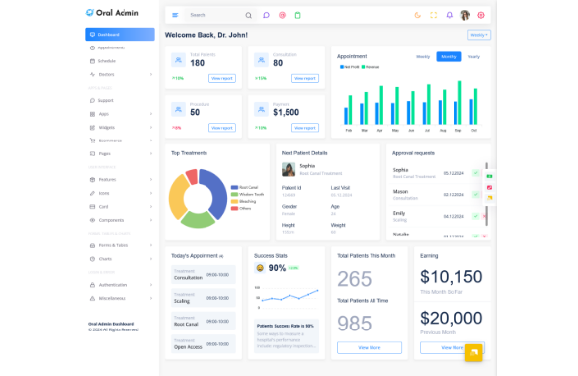
ADMINISTRATIVE CONTROL
Provider Management Dashboard
Dynamic Availability Control
Instant leave management, emergency slot overrides, and break rules.
Utilization Analytics
Real-time reporting on peak booking hours, cancellation causes, and revenue.
Multi-Location Support
Manage multiple clinic branches and doctor rotations in a single portal.

Slide 7
MEASURABLE OUTCOMES
Quantifiable Healthcare Impact
35%
40%
24/7
Reduction in No-Shows
Lower Admin Workload
Patient Access Flexibility
Driven by automated SMS and WhatsApp reminders.
Automated scheduling frees front-desk staff efficiency.
Over 60% of bookings made outside clinic working hours.

Slide 8
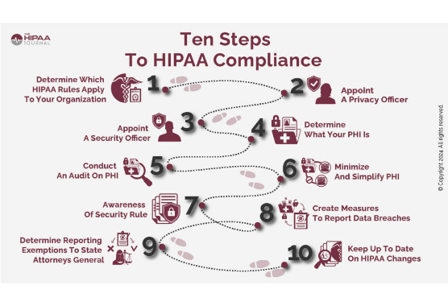
TRUST & COMPLIANCE
Security & Compliance Framework
HIPAA & Data Privacy
Full alignment with healthcare privacy standards and encrypted record storage.
End-to-End Encryption
AES-256 bit data encryption in transit and at rest for patient records.
Role-Based Access Control
Strict permission levels for patients, front desk, and medical personnel.

Slide 9
SYSTEM ARCHITECTURE
Technology & Integrations
Frontend Portal
Backend & Database
Responsive React / Web & Mobile applications for cross-platform booking convenience.
Node.js / Python microservices paired with encrypted PostgreSQL database.
EHR / EMR Integration
Messaging Gateways
HL7 / FHIR standard API sync with hospital medical records and billing systems.
Twilio & WhatsApp Business API integration for instant notification dispatch.

Slide 10

Thank You!
Revolutionizing patient care access through modern, efficient, and secure scheduling technology.
Questions & Discussion

Slide 11




Image Sources
https://cdn.dribbble.com/userupload/43541966/file/original-c8bce5e7d75a6854b4621b8d6f7bff11.jpg
Source: dribbble.com
https://media.istockphoto.com/id/928698218/photo/doctor-and-family-consulting-patient-lying-on-hospital-bed-talking-happy-about-the-diagnose.jpg?s=612x612&w=is&k=20&c=L3AmRIRkq9cFPwyaknjD_pxpHAOCsd_YtcH72CjDYyU=
Source: www.istockphoto.com
https://multipurposethemes.com/wp-content/uploads/2025/06/Oral-Admin-Dental-Dashboard-1024x924.png
Source: multipurposethemes.com
https://www.hipaajournal.com/wp-content/uploads/2024/02/Ten-Steps-to-HIPAA-Compliance-1024x598.jpg
Source: www.hipaajournal.com

